Slide 1
Culturally-Based Education
By
David Perley
(March 25, 2021)

Slide 2
What is Culturally-Based Education?
“Education which reflects, validates and promotes the values, world views, and language(s) of the community’s culture. CBE is intended to honour all forms of knowledge, ways of knowing and world views equally. The goal of CBE is to support all students through affirmation of their culture. It builds a sense of pride and self-esteem, which is the best gift any teacher can give to his/her students.”
(North West Territories Teacher Induction Program)

Slide 3

Elements of Culturally-Based
Education Program
Incorporates Wolastoqey culture and language
Adopts pedagogical practices that reflect Wolastoqey culture
Adopts teaching strategies that are congruent with Wolastoqey culture and in particular ways of knowing and learning

Slide 4
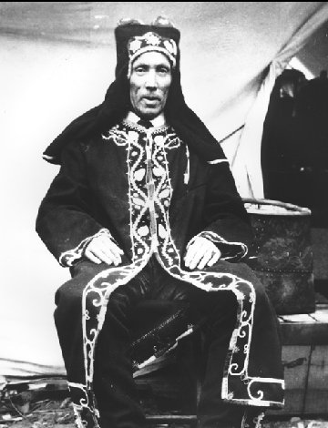
Elements of Culturally Based
Education Program
Implements a curriculum based on Wolastoqey culture
Encourages community participation in general and school activities in particular
Acknowledges and incorporates the knowledge, values, and world views of Wabanaki communities

Slide 5
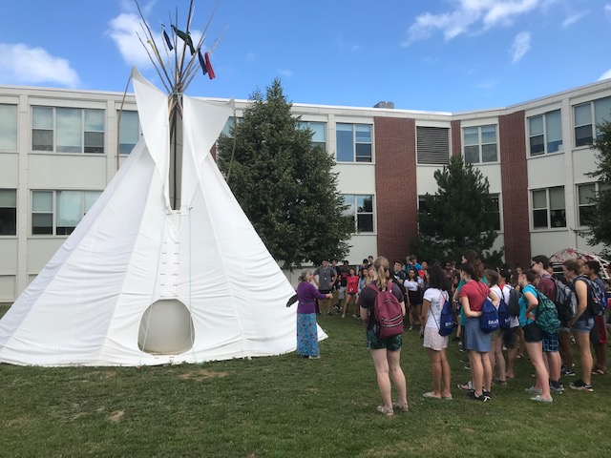
Culturally-Based Education Program
Expectations for Schools
Support culture-based educational expectations for students and teachers
Accommodate Wolastoqey learning styles through the use of appropriate teaching styles
Reflect the local Wolastoqey culture and environment

Slide 6
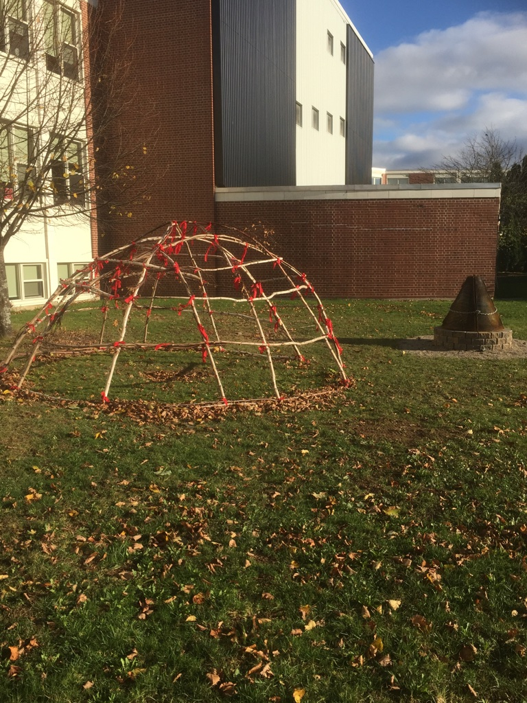
Culture-Based Education Program
Expectations for Schools
Involve Elders as part of the program
Provide Wolastoqey language program
Provide professional development opportunities to orient teachers to Wolastoqey culture, language, world views and traditions

Slide 7
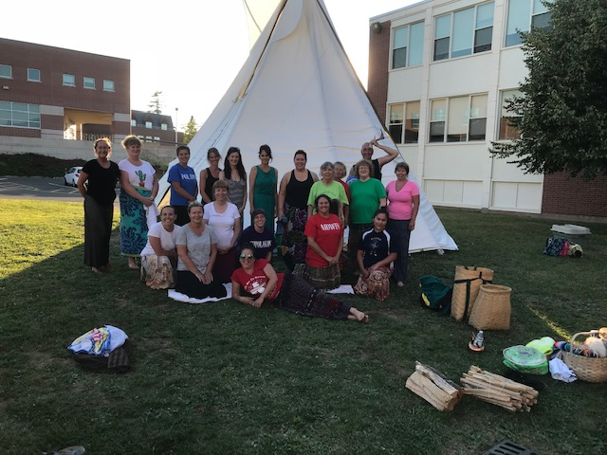
Culture-Based Education Program
Expectations for Teachers
Incorporate Wolastoqey culture into their teaching
Use local materials and local human resources
Participate in the community, outside the school

Slide 8
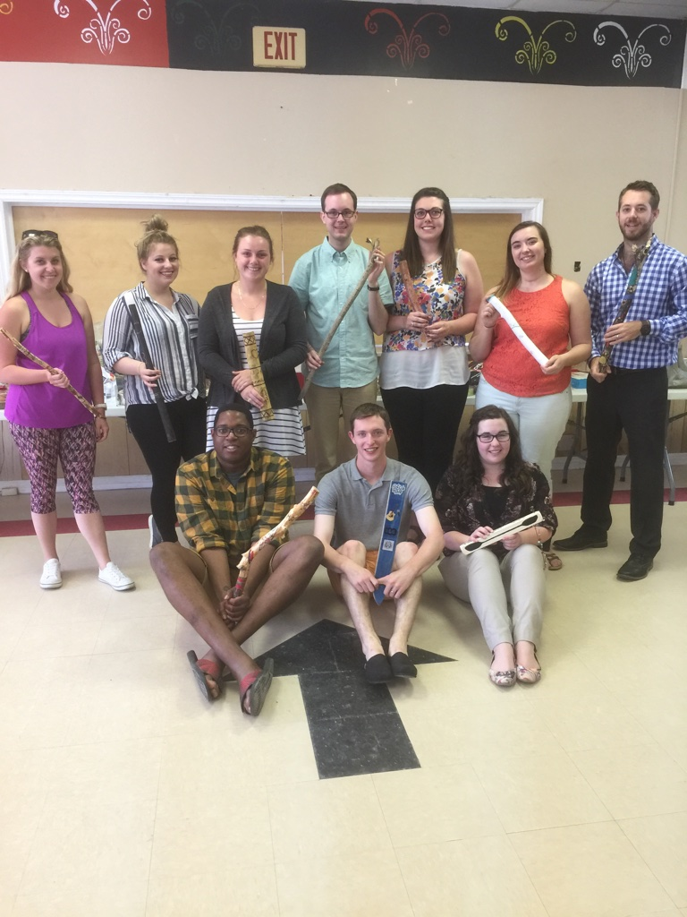
Culture-Based Education Program
Expectations for Teachers
Work in partnership with parents
Challenge each student to find and develop his/her individual strength
Find mechanisms to incorporate Wolastoqey culture and language throughout the school

Slide 9
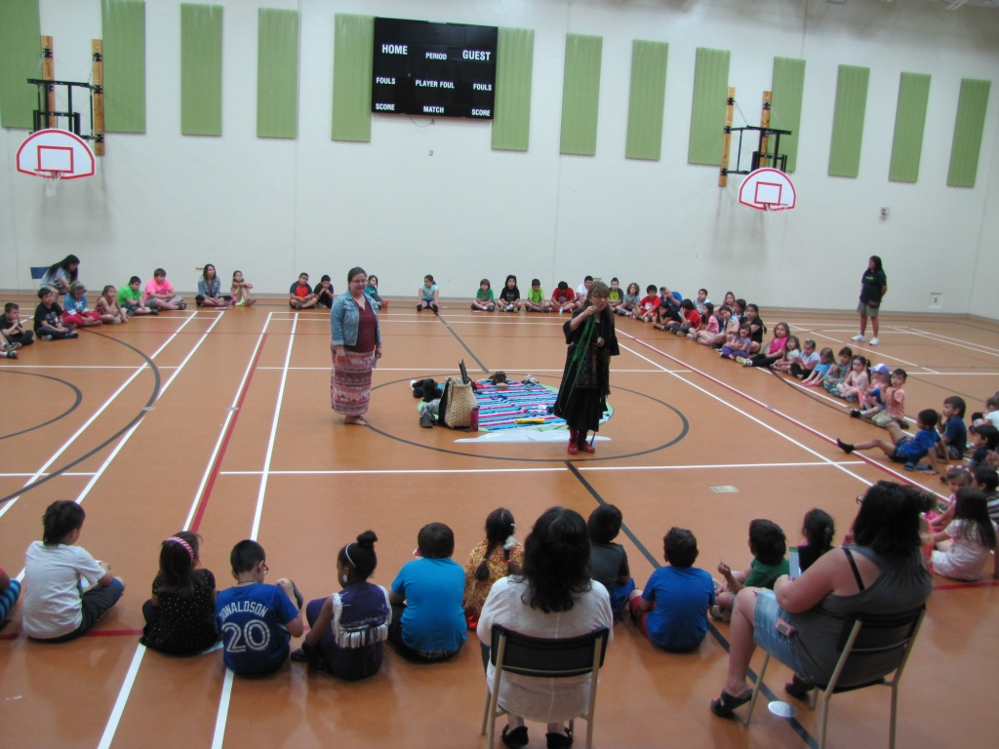
Culture-Based Education Program
Expectations for Students
Develop a strong foundation of their Wolastoqey identity
Knowledgeable about their history, traditions, values and language
Comfortable in various cultures
Developing a balanced approach to life
Connecting to the world

Slide 10
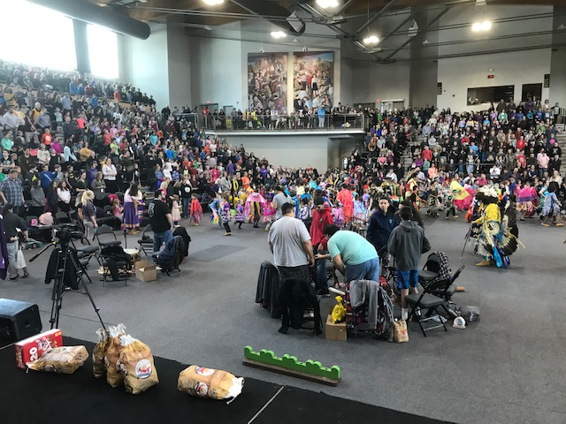
Culturally-Based Education Program
Culturally-responsive teachers and administrators
Culturally-knowledgeable students

Slide 11
Culturally-Based Education Program
First, culture-based education (CBE) positively impacts student socio-emotional well-being (e.g., identity, self-efficacy, social relationships). Second, enhanced socio-emotional well-being, in turn, positively affects academic outcomes.
The data support the hypothesis that cultural approaches strongly enhance relevance and relationships at school, while also supporting positive academic outcomes (pp. 17)
Source: “Culture-based Education and Its Relationship to Student Outcomes” by Shawn Kana’iaupuni, Brandon Ledward and “Umi Jensen in Kamehameha Schools Research and Evaluation Division, September, 2010.

